Slide 1
Sequential Building Blocks

Slide 2
Index
Building Blocks
Counters
Digitally Controlled Oscillator (DCO)
Shift Registers
Scan Chains
Memory Arrays
Bit Cell
Dynamic Random Access Memory (DRAM)
Static Random Access Memory (SRAM)
Register Files
Read Only Memory (ROM)
Programmable ROM (PROM)
Lookup tables (LUT)
Programmable Logic Array (PLA)
Field Programmable Gate Array (FPGA)

Slide 3
Building Blocks
Like Combinational logic, also Sequential logic is often grouped into larger building blocks to build more complex systems
principles of abstraction, hierarchy, modularity, and regularity
hiding the unnecessary gate-level details to emphasize the function of the building block
hierarchically assembled from simpler components
a well-defined interface and can be treated as a black box
Examples:
Counters
Registers
Memory
PLA
FPGA
We will use many of these building blocks to build a microprocessor

Slide 4
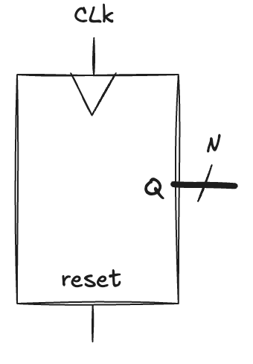
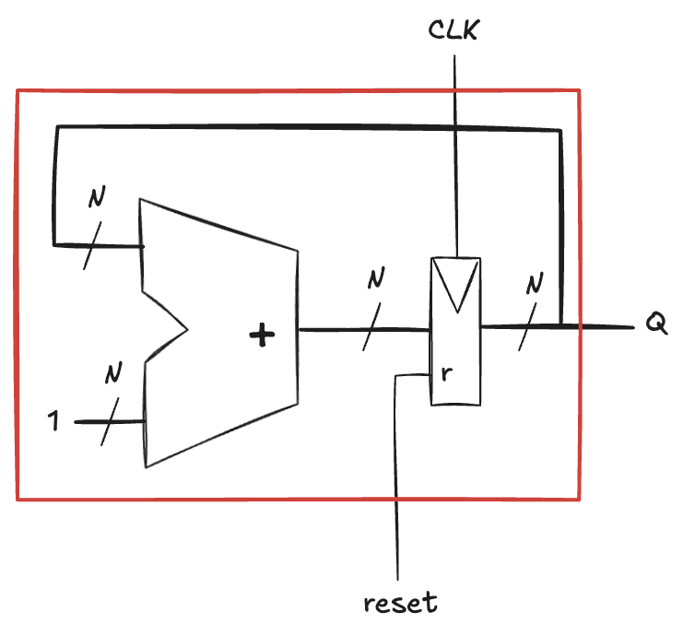
Counters
A device that advances through all 2^{N} possible outputs in binary order
incrementing on the rising edge of the clock
Reset initializes the output to 0
A possible implementation composed of an adder and a resettable register
on each cycle, the counter adds 1 to the value stored in the register
the most significant bit toggles every 2^{N} cycles
It can be used to reduces the frequency of the clock by a factor of 2^{N}
useful for slowing down fast signals
a digital system with a 50MHz clock, can be slowed with a 24-bit counter to produce a 2.98Hz signal that blinks a LED at a rate the human eye can observe

Slide 5
Digitally Controlled Oscillator (DCO)
A counter generalization to produce arbitrary frequencies
A N-bit counter that adds p on each cycle, rather than 1
if the clock has frequency f_{clk}, the most significant bit now toggles at f_{out} = f_{clk} * p/2^{N}
Selecting p and N, we can produce an output of any frequency
larger N gives more precise control at the expense of more hardware
Suppose we have a 50 MHz clock and want to produce a 500 Hz output
consider using an N=24 or 32 bit counter
we want p/2^{N} = 500Hz/50MHz = 0.00001
if N=24, choose p=168 to get f_{out}=500.68Hz
if N=32, choose p=42950 to get f_{out}=500.038 Hz

Slide 6
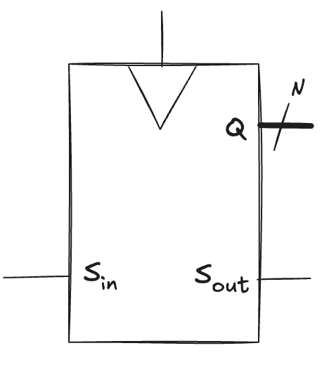
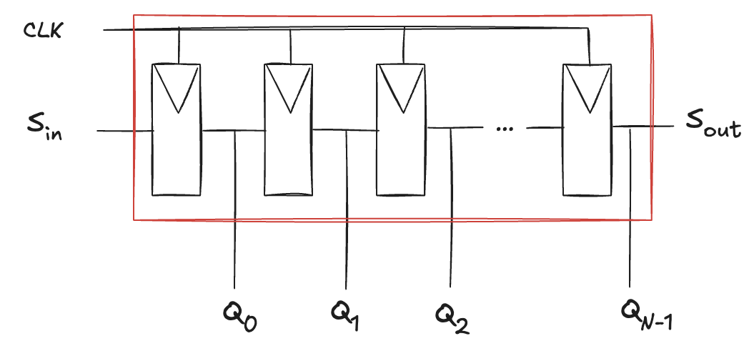
Shift Registers (1)
A device that shift in a new bit on each clock edge
on each rising edge of the clock, a new bit is shifted in from S_{in} and all the subsequent contents are shifted forward
the last bit in the shift register is available at S_{out}
It can be constructed from N flip-flops connected in series
Don’t confuse shift registers with shifters
shifters are un-clocked combinational blocks that shift an input by a specified amount
Can be viewed as serial-to-parallel converter
the input is provided serially (one bit at a time) at S_{in}
after N cycles, the past N inputs are available in parallel at Q

Slide 7
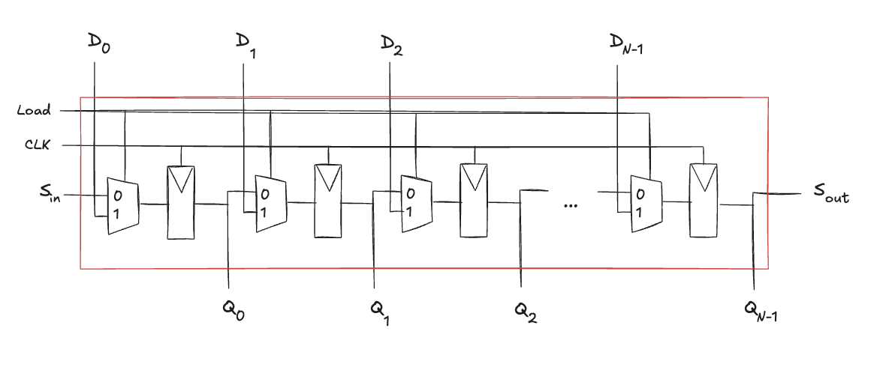
Shift Registers (2)
A related circuit is a parallel-to-serial converter
it loads N bits in parallel
then shifts them out one at a time
A shift register can be modified to perform both serial-to-parallel and parallel-to-serial operations by adding a parallel input D_{N−1:0} and a control signal
when Load is asserted, the flip-flops are loaded in parallel from the D inputs
otherwise, the shift register shifts normally

Slide 8
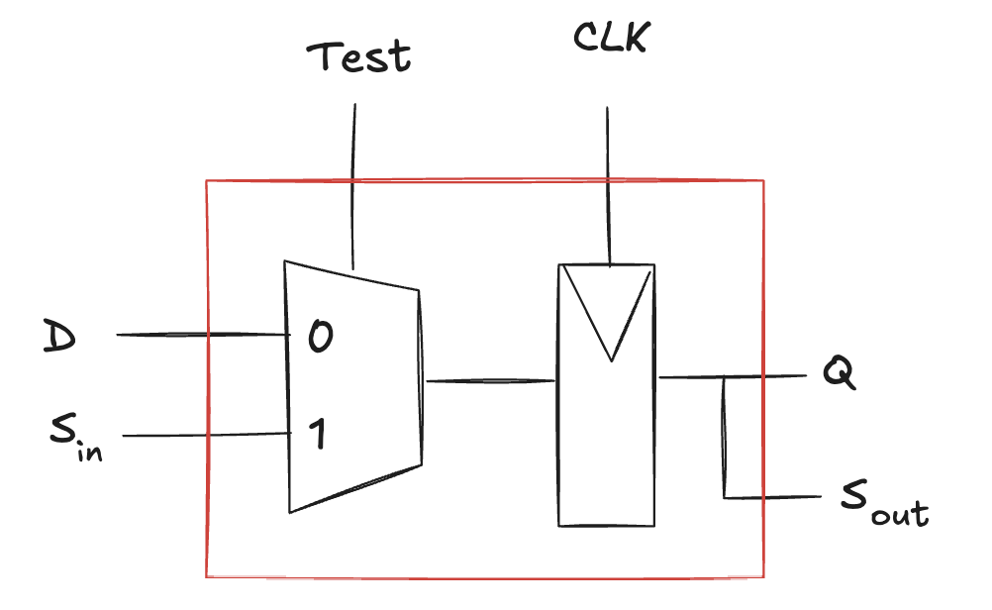
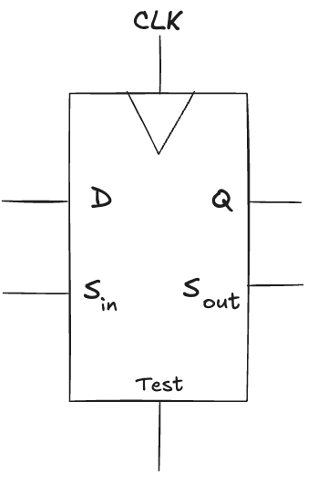
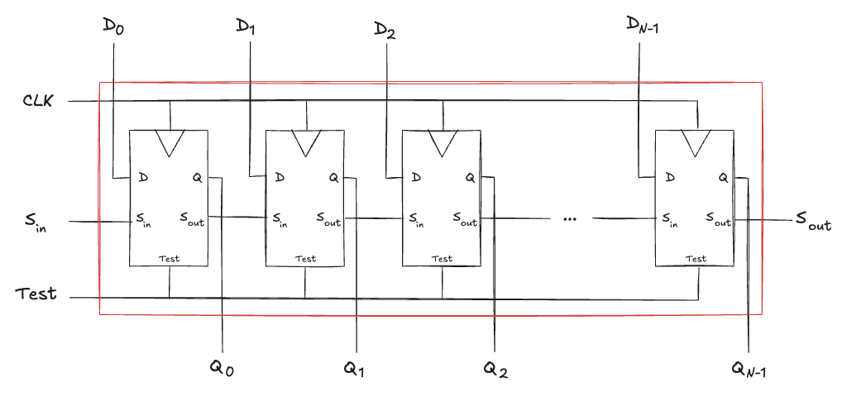
Scan Chains
Testing combinational circuits is relatively straightforward
known inputs (test vectors) are applied, and outputs are checked
Testing sequential circuits is more difficult because the circuits have state
many cycles of test vectors may be needed to put the circuit into a state
testing that the msb of a 32-bit counter requires 2³¹ clock pulses!
Directly control the state, flip-flops connected into a shift register (scan chain)
in normal operation, flip-flops load data from their input D
in test mode, flip-flops serially shift contents using S_{in} and S_{out}
The example:
32-bit counter can be tested by shifting in the pattern 011111…111 in test mode, counting for one cycle, then shifting out the result, which should be 100000…000
this requires 32 + 1 + 32 = 65 cycles

Slide 9
Memory (1)
Digital systems require memories to store data used and generated by circuits
registers are a kind of memory that stores small amounts of data
Memory arrays can efficiently store large amounts of data
Memories are classified based on how they store bits
Random Access Memory (RAM)
volatile: loses data when the power is turned off
Read Only Memory (ROM)
non-volatile: retains its data indefinitely, even without a power source
Names for historical reasons: no longer very meaningful
RAM accesses data with the same delay, in contrast with sequential access memory (e.g. tape recorder accesses nearby data more quickly than faraway data)
ROM historically could only be read, but not written
These names are confusing
ROMs are also randomly accessed…
worse yet, modern ROMs can be written as well as read…
Just one important distinction: volatile and non-volatile

Slide 10
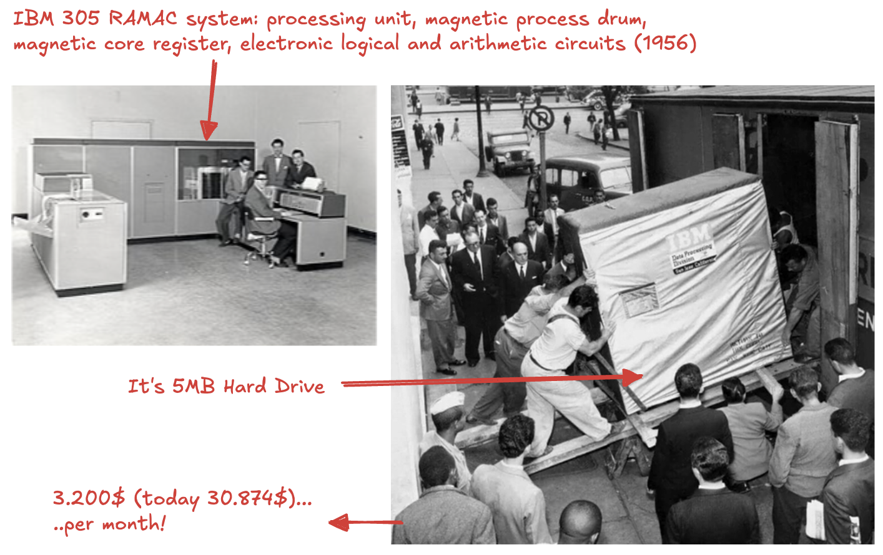
Memory (2)

Slide 11
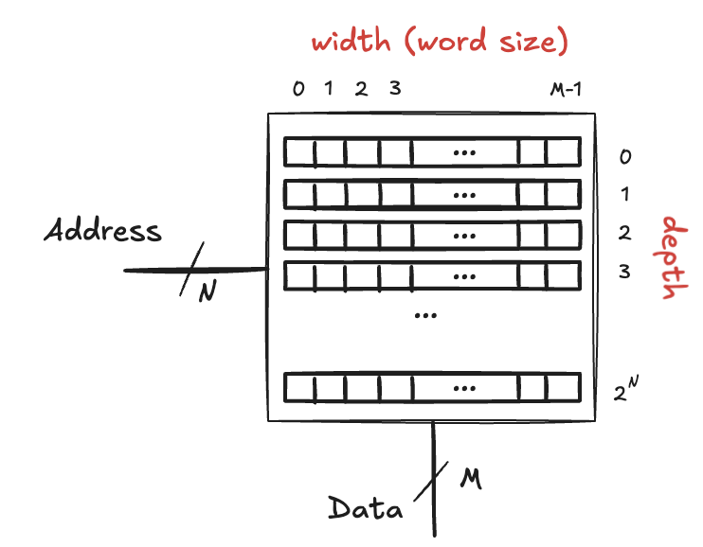
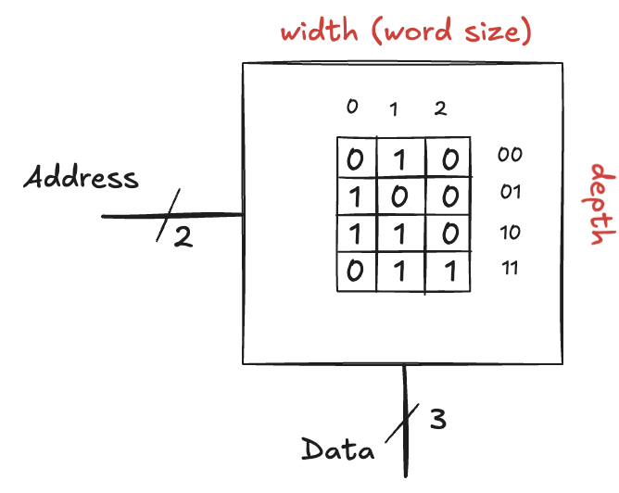
Memory Arrays
Memory is organized as a two-dimensional array of memory cells
row is specified by an address
depth of an array is the number of rows
value read or written is called data
width is the number of columns, also called the word size
Memory with N-bit address and M-bit data has 2^{N} rows and M columns
Memory size is given as depth * width
Example:
a memory array with two address bits and three data bits
the two address bits specify one of the four rows (data words)
each data word is three bits wide
it is a 4-word * 3-bit array, or simply 4 × 3 memory

Slide 12
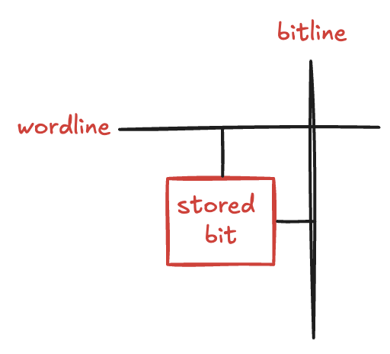
Bit Cell (1)
Memory arrays are built as an array of bit cells
each of which stores 1 bit of data
Each bit cell is connected to a wordline and a bitline
for each combination of address bits, the memory asserts a single wordline that activates the bit cells in that row
when the wordline is HIGH, the stored bit transfers to or from the bitline
otherwise, the bitline is disconnected from the bit cell
The circuitry to store the bit varies with memory type
To read a bit cell
the bitline is left floating (Z)
then the wordline is turned ON, allowing the stored value to drive the bitline
To write a bit cell
the bitline is strongly driven to the desired value
then, the wordline is turned ON, connecting the bitline to the stored bit
the strongly driven bitline overpowers the contents of the bit cell, writing the desired value into the stored bit

Slide 13
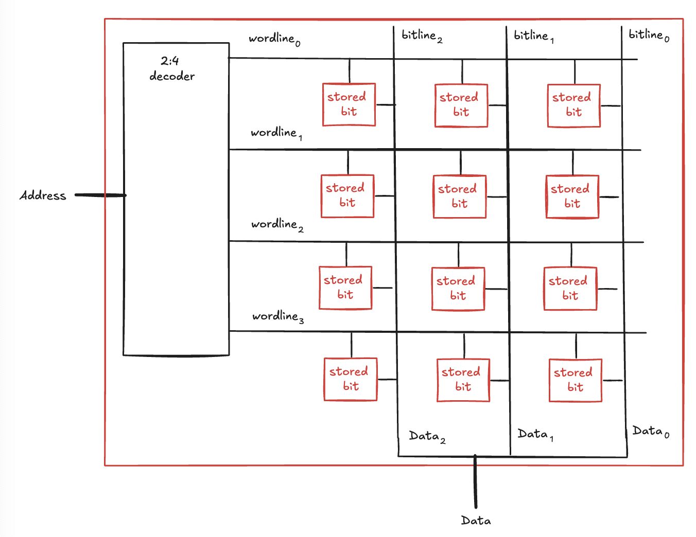
Bit Cell (2)
The figure shows the internal organization of a 4 * 3 memory array

Slide 14
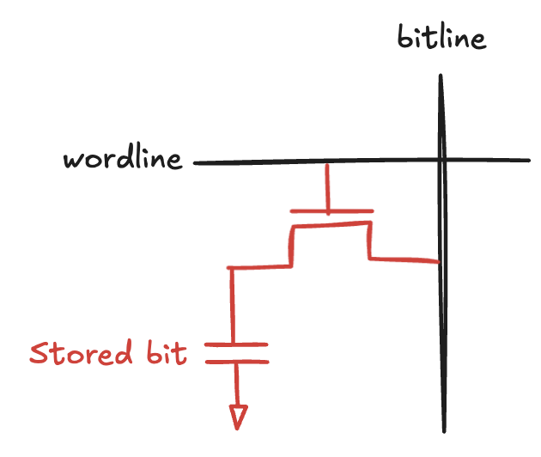
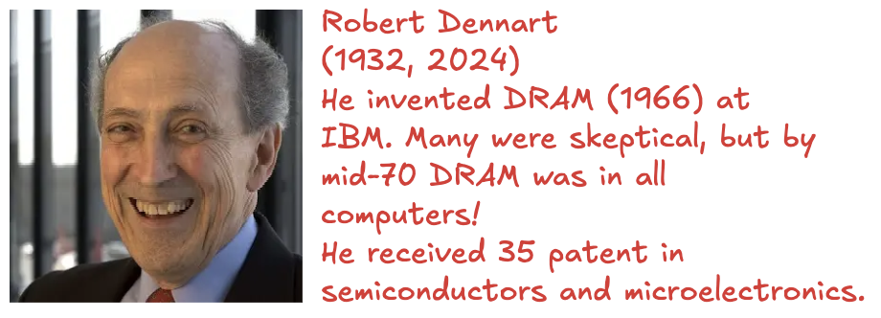
Dynamic Random Access Memory (DRAM)
DRAM stores data as a charge on a capacitor
transistor behaves as a switch
connects or disconnects the capacitor from the bitline
when the capacitor is charged to VDD, the stored bit is 1
when it is discharged to GND, the stored bit is 0
Upon a write, data values are transferred from the bitline to the capacitor
Upon a read, data are transferred from the capacitor to the bitline
Reading destroys the bit stored on the capacitor
data must be restored (rewritten) after each read
even when it is not read, the contents must be refreshed (read and rewritten)
every few milliseconds
the charge on the capacitor gradually leaks away

Slide 15
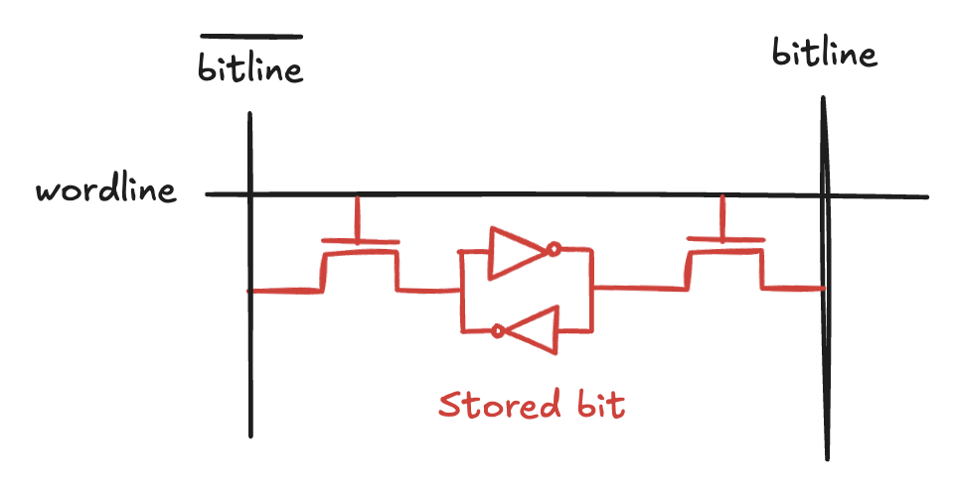
Static Random Access Memory (SRAM)
The data bit is stored on cross-coupled inverters
Each cell has two outputs, bitline and bitline
when the wordline is asserted, both transistors turn on
data values are transferred to or from the bitlines
Do not need to be refreshed

Slide 16
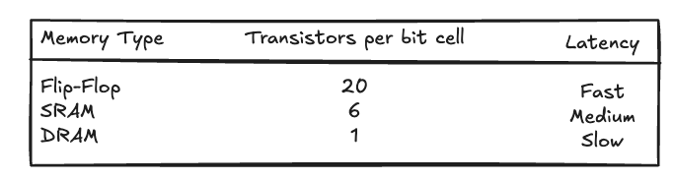
Memory comparison
Flip-flops, SRAM, and DRAM are all volatile memories, but each has different area and delay characteristics
Flip-flop data is available immediately in output, but it takes at least 20 transistors
DRAM is slower
must wait for charge to move (relatively) slowly from the capacitor
must refresh data periodically and after a read
Today, modern DRAM technologies (synchronous and double data rate, DDR)
uses both rising and falling edges of the clock to access data
first standardized in 2000 (100 MHz), today (2021) speeds over 3 GHz
The best memory type for a particular design depends on the speed, cost, and power constraints

Slide 17
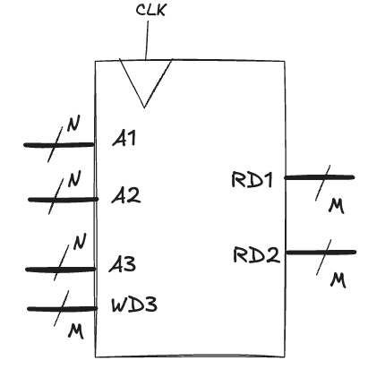
Register Files
A set of registers used to store temporary variables
Usually built as a small, multi-ported SRAM array
more compact than an array of flip-flops
multi-ported means that can access several addresses simultaneously
For example, a 32-register (N=5) with 32-bit (M=32) three-ported register file
two read ports (A1->RD1 and A2->RD2)
one write port (A3->WD3)
the 5-bit addresses (A1, A2, A3) can access all 2⁵ = 32 registers
two registers can be read and one register written simultaneously
Sometimes, a particular register is hardwired to always read the value 0
because 0 is a commonly used constant

Slide 18
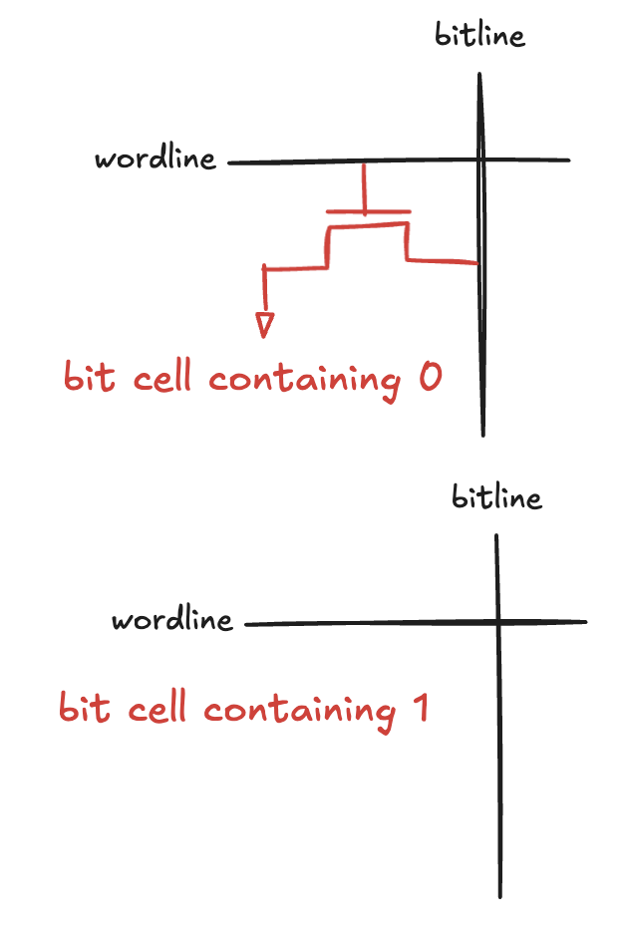
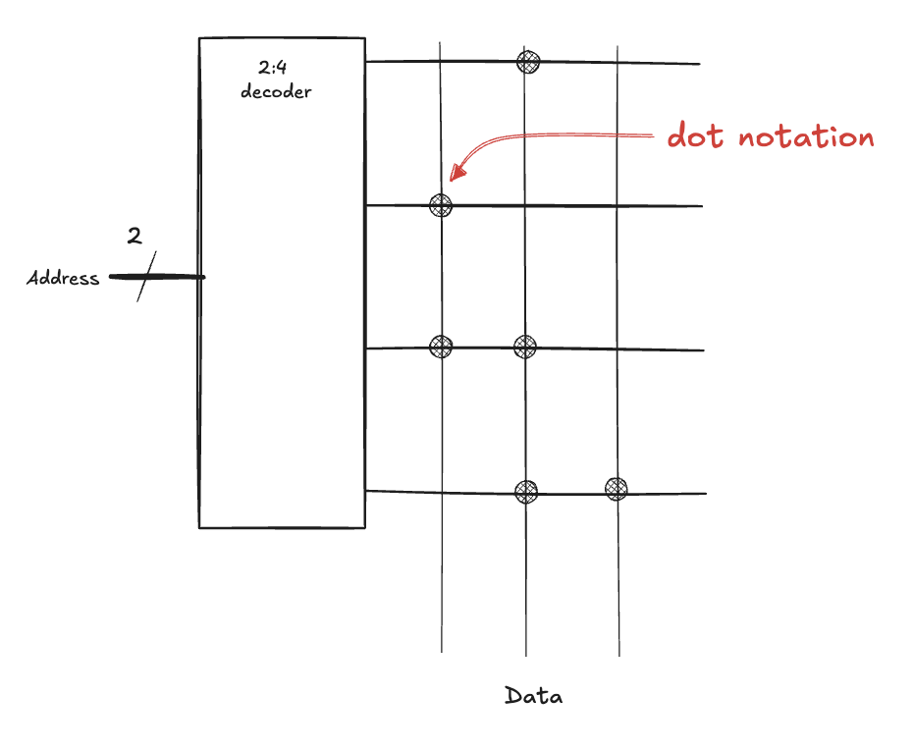
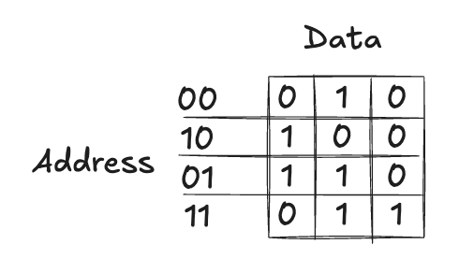
Read Only Memory (ROM) (1)
ROM stores a bit as the presence or absence of a transistor
To read the cell:
the bitline is weakly pulled HIGH
then, the wordline is turned ON
if the transistor is present, it pulls the bitline LOW
if it is absent, the bitline remains HIGH
The contents of a ROM can be indicated using dot notation

Slide 19
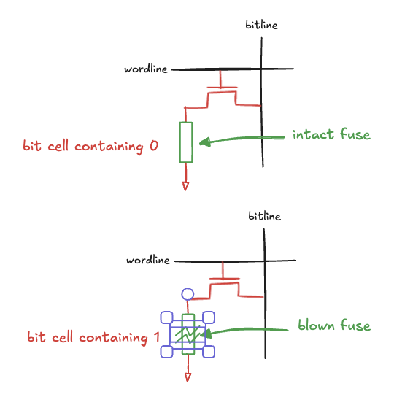
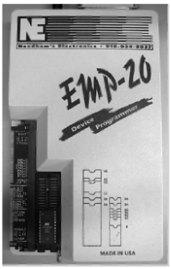
Programmable ROM
Places a transistor in every bit cell, but provides a way to connect or disconnect the transistor to ground
User programs the ROM by applying a high voltage to selectively blow fuses
if the fuse is present, transistor is connected to GND and the cell holds 0
if the fuse is destroyed, transistor is disconnected from ground and the cell holds 1
One-time programmable ROM
because the fuse cannot be repaired once it is blown
The process id called burning a ROM
Exist also reversible mechanism for connecting or disconnecting the transistor

Slide 20
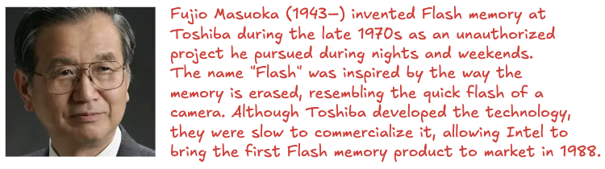
Re-programmable ROM
Erasable PROMs (EPROM)
replace the transistor and fuse with a floating-gate transistor
not physically attached to any other wires
when high voltages are applied, electrons tunnel through an insulator onto the floating gate, turning on the transistor and connecting the bitline to the wordline
when exposed to ultraviolet light (half an hour), the electrons are knocked off the floating gate, turning the transistor off
these actions are called programming and erasing
Electrically erasable PROMs (EEPROM) and Flash memory
use similar principles but include circuitry for erasing and programming
in 2021, Flash cost about $0.1 per GB, and price is dropping
a way to store large amounts of data in portable battery-powered systems
ROMs are not really read only: they can be programmed
difference between RAM and ROM: ROMs take a longer time to write but are non-volatile

Slide 21
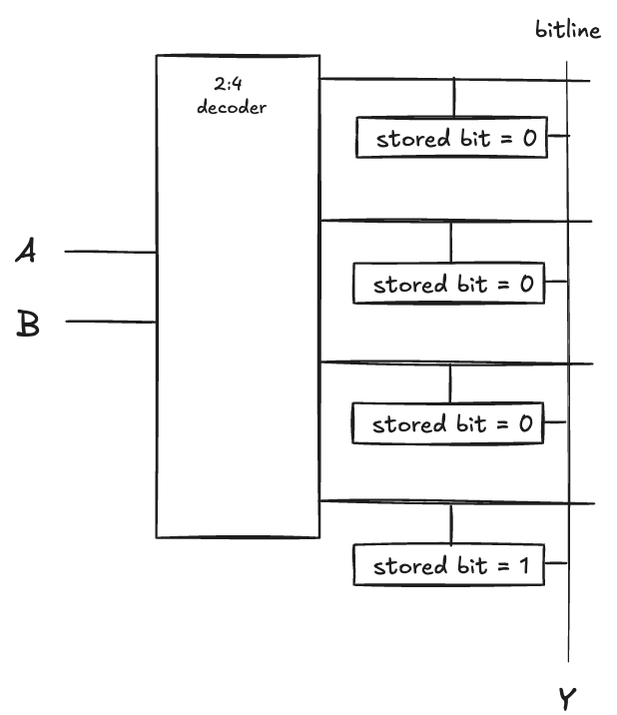
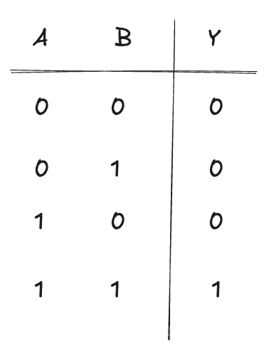
Lookup tables (LUT)
Memory arrays can also perform combinational logic functions
each address corresponds to a row in the truth table
each data bit corresponds to an output value
Data2 is the XOR of the two address inputs
Data0 is the NOR of the two inputs
A 2^{N}-word × M-bit memory can perform any combinational function of N inputs and M outputs
The following figure shows a LUT (4-word × -bit) to perform the function Y = AB

Slide 22
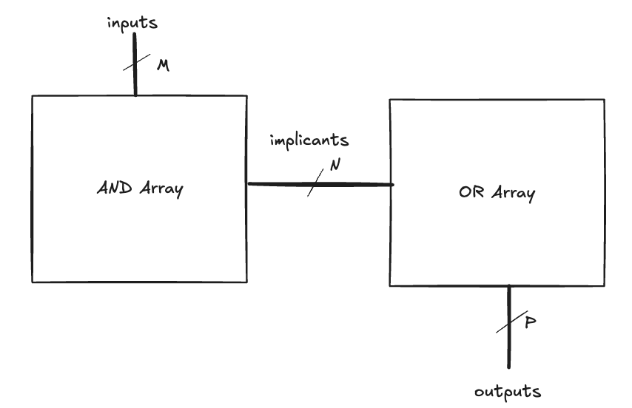
Programmable Logic Array (PLA)
Like memory, gates can be organized into regular arrays
if connections are made programmable, they can be configured to perform any function
PLA implement two-level combinational logic in sum-of-products form
the inputs (in true and complementary form) drive an AND array
which produces implicants
the implicants, in turn, are ORed together to form the outputs
An M×N×P-bit PLA has M inputs, N implicants, and P outputs

Slide 23
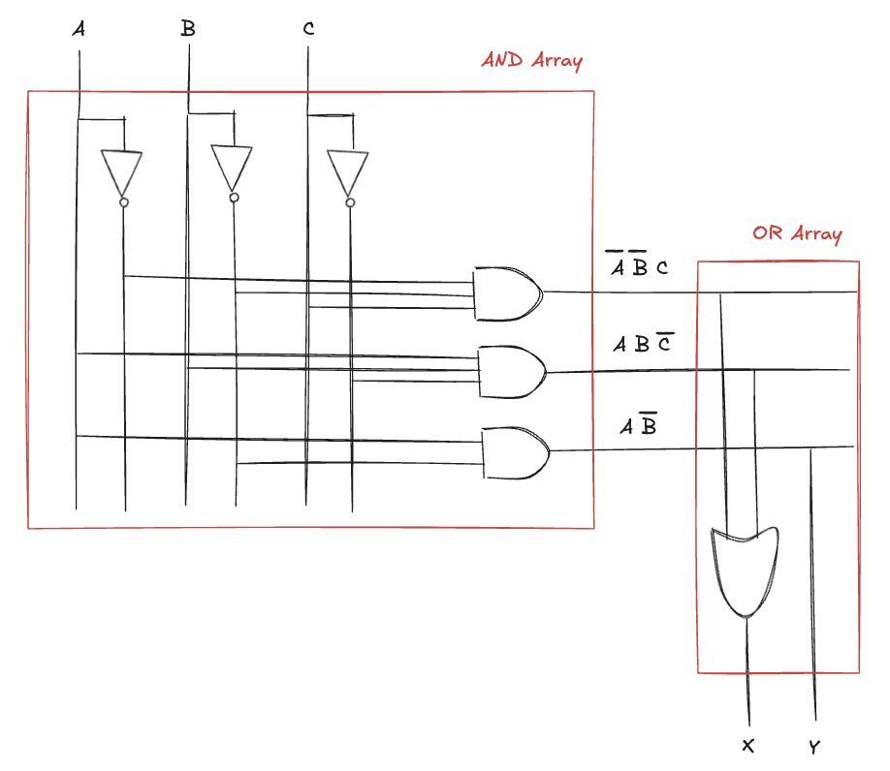
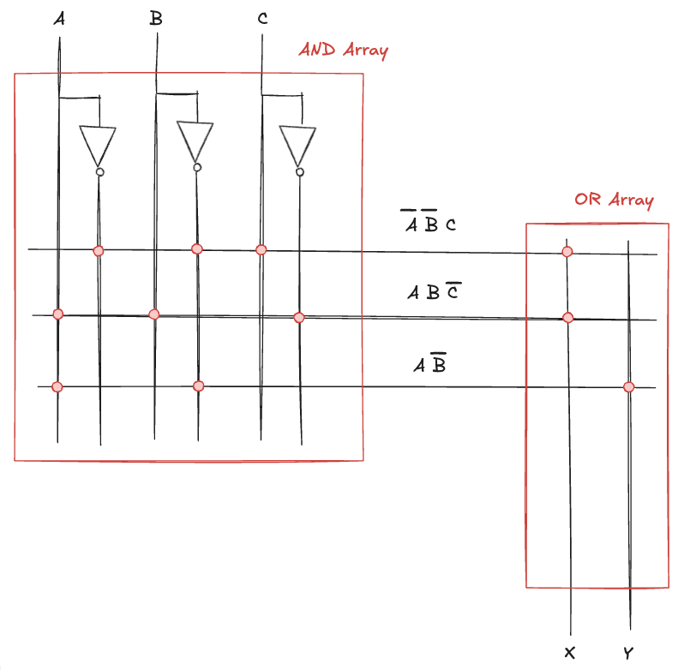

Programmable Logic Array (PLA)
Example:
ROMs can be viewed as a special case of PLAs
A 2^{M}-word×N-bit ROM is simply an M×2^{M}×N-bit PLA
the decoder behaves as an AND plane that produces all 2^{M} minterms
the ROM array behaves as the OR plane that produces the outputs
If function does not depend on all minterms, PLA is smaller than a ROM
PLAs have largely been displaced by FPGAs, which are more flexible and efficient

Slide 24
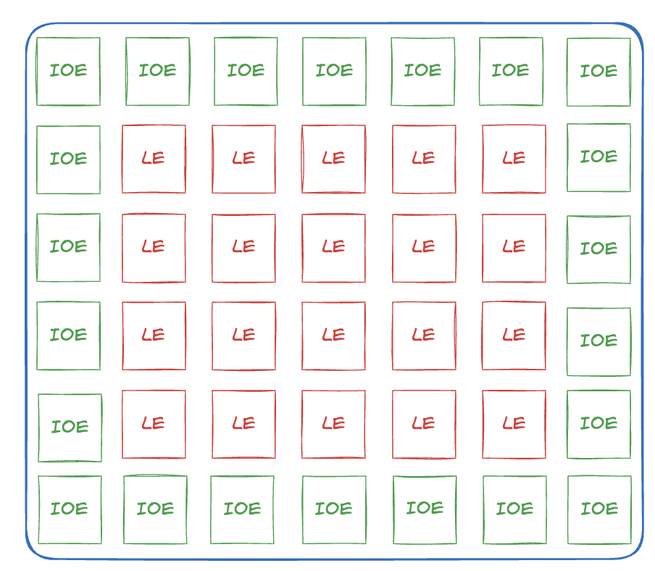
Field Programmable Gate Array (FPGA) (1)
An array of reconfigurable logic elements (LE)
user can implement designs employing either an Hardware Description Language (HDL) or a schematic
each LE can be configured to perform combinational or sequential functions
LEs are surrounded by input/output elements (IOE) for interfacing with the outside world
IOEs inputs and outputs to pins on the chip package
LEs can connect to other LEs and IOEs through programmable routing channels
FPGAs are more powerful and more flexible than PLAs
can implement both combinational and sequential logic
can implement multilevel logic functions (not just two-level logic)
FPGAs are used on several consumer produces
Mercedes Benz S-Class has over a dozed on Xilinx FPGAs
quick time-to-market

Slide 25
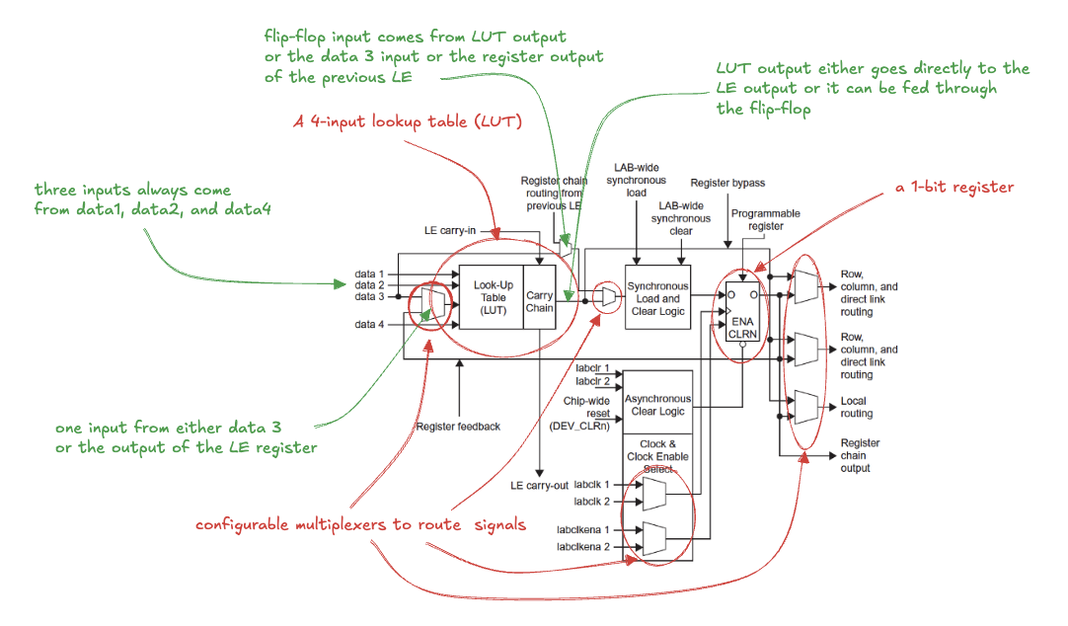
Field Programmable Gate Array (FPGA) (2)
A single LE from Intel’s Cyclone IV FPGA

Slide 26
Field Programmable Gate Array (FPGA) (3)
Other brands of FPGA are organized somewhat differently, but the same general principles apply.
for example, Xilinx’s 7-series FPGAs use 6-input LUTs instead of 4-input LUTs
The designer configures an FPGA by first creating a schematic or HDL description of the design
the design is then synthesized onto the FPGA
synthesis tool determines how the LUTs, multiplexers, and routing channels should be configured to perform the specified functions
This configuration information is then downloaded to the FPGA
Cyclone IV FPGAs store their configuration information in SRAM and then are easily reprogrammed
FPGA may download its SRAM contents from a computer or from an EEPROM chip when the system is turned on
some manufacturers include an EEPROM directly on the FPGA or use one-time programmable fuses to configure the FPGA
DEEDS is capable of creating an HDL description of your schematic that can be deployed on a real FPGA, as we will see in the next semester!

